Slide 1
OSDU April 2023 Øivind Berggraf - TDI EDT EDP
Link to Equinor OSDU high-level info page
( https://statoilsrm.sharepoint.com/sites/SubsurfaceM2C/SitePages/OSDU%E2%84%A2%20Data%20Platform.aspxm )

Slide 2
OSDU April 2023 Øivind Berggraf - TDI EDT EDP
JMOR
Link to Equinor OSDU high-level info page
( https://statoilsrm.sharepoint.com/sites/SubsurfaceM2C/SitePages/OSDU%E2%84%A2%20Data%20Platform.aspxm )

Slide 3
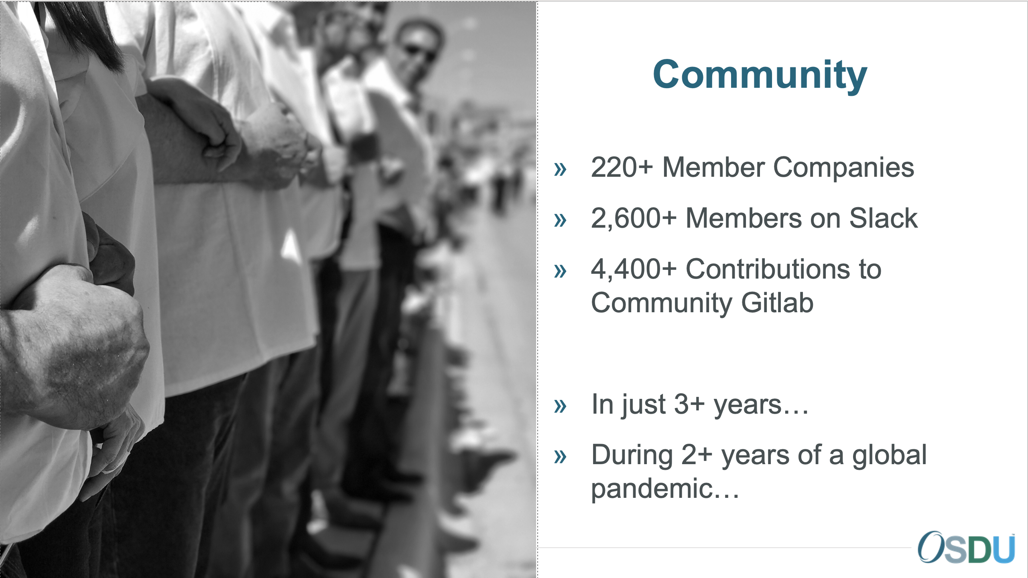
What is OSDU
Cross industry effort
Open Source Software Project
Prosperous and growing community
Data Platform initiative to achieve
Interoperability and accelerate innovation
A long-term goal to drive down costs
A pathway for a cloud-native migration
Serves, but not restricted to the subsurface
Continuously delivering new version and capabilities.
Very good involvement and increased adaption from operators, service/solution providers and cloud service providers.
The OSDU Forum Mission:
The Open Group OSDU Forum delivers an Open Source, standards-based, technology-agnostic data platform for the energy industry that stimulates innovation, industrialize data management, and reduced time to market for new solutions.
Equinor a founding member

Slide 4

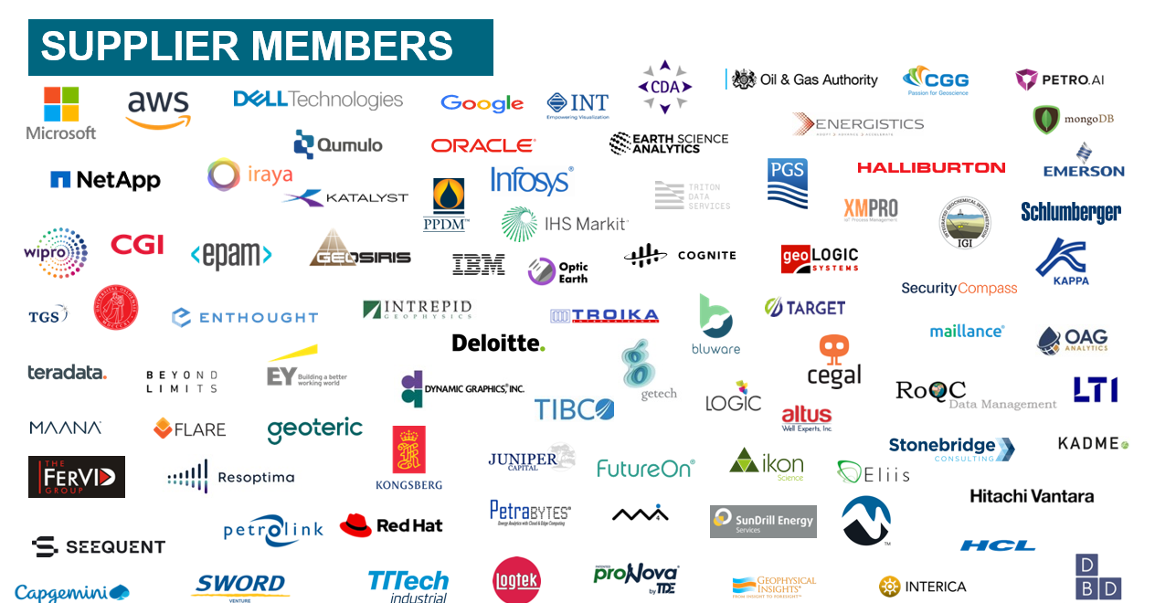
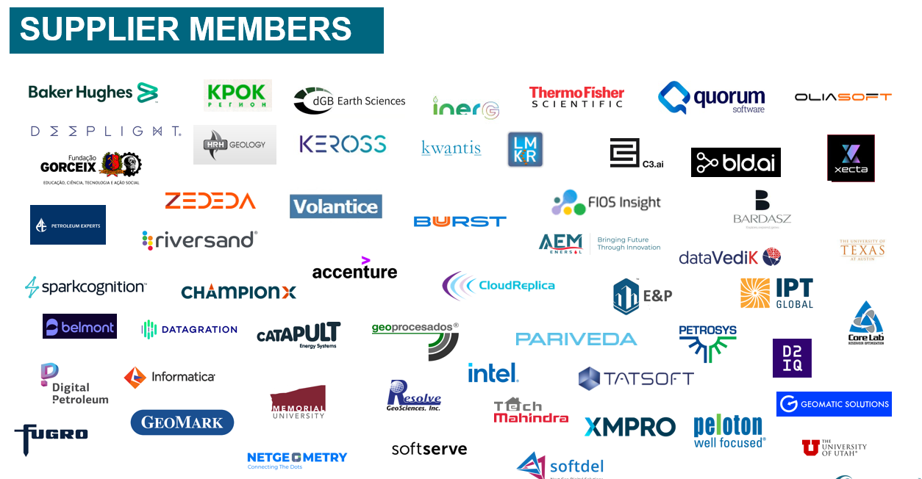
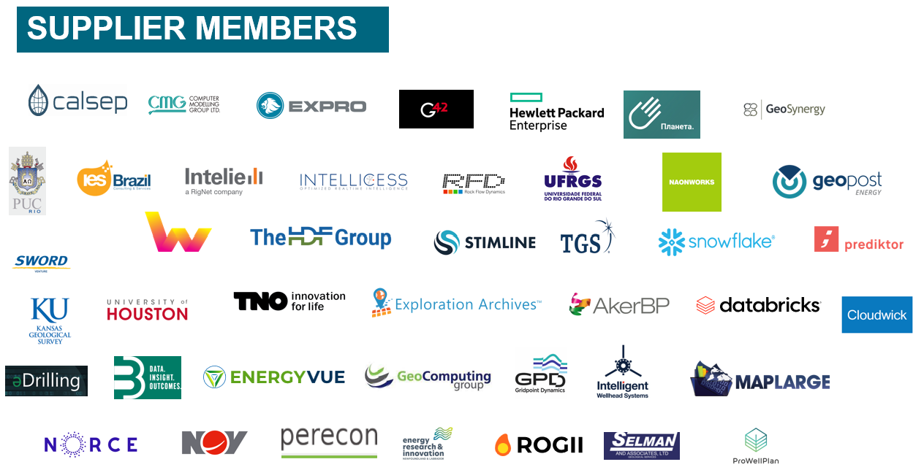
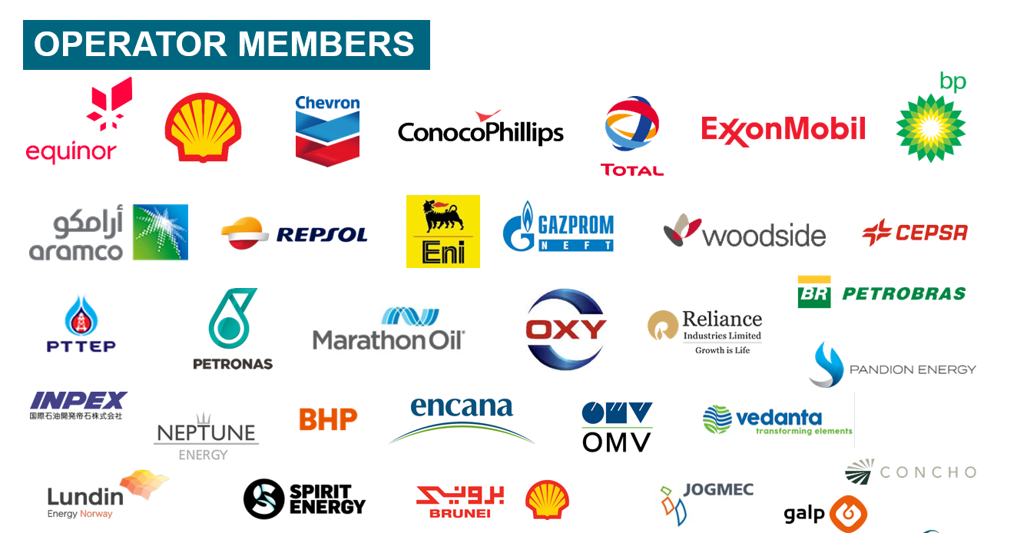
The Open Group OSDU Forum was founded in H2 2018 and the membership as of now consists of:
30+ operators
175+ oilfield services & software companies
10+ academic institutions
4+ cloud services providers

Slide 5

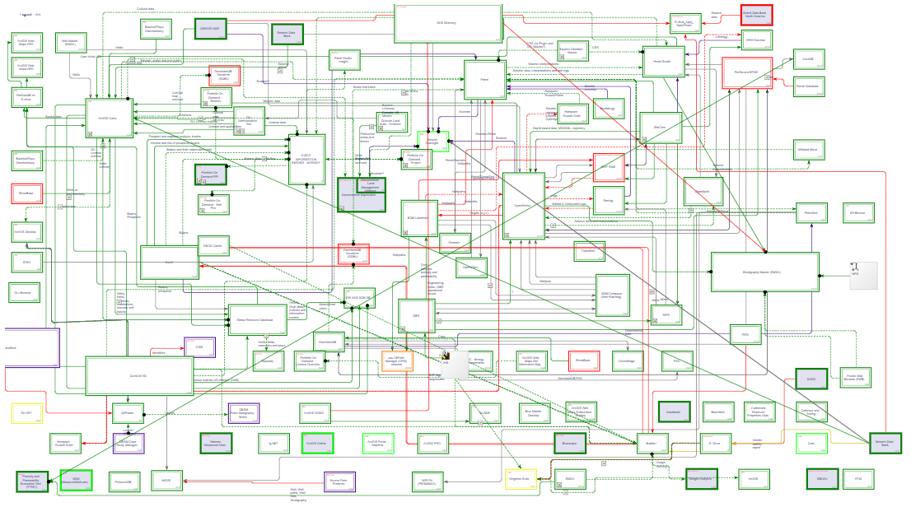
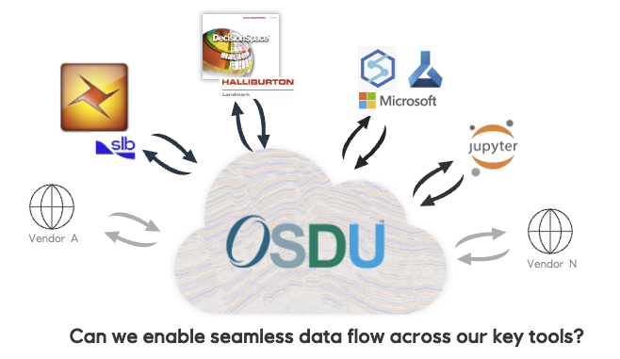
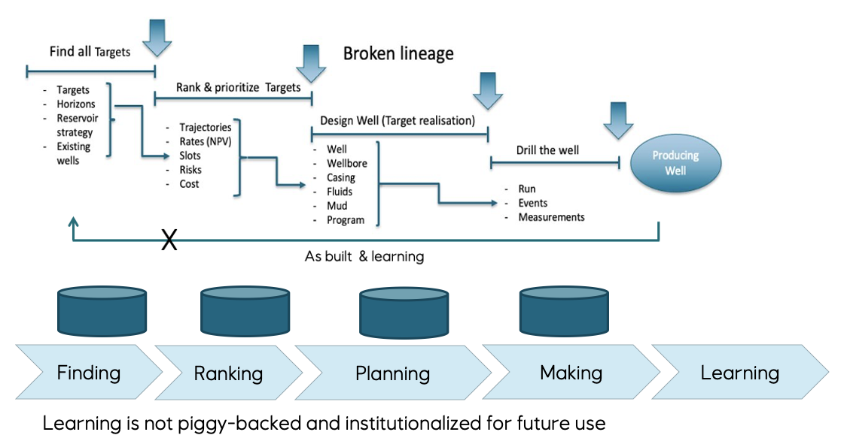
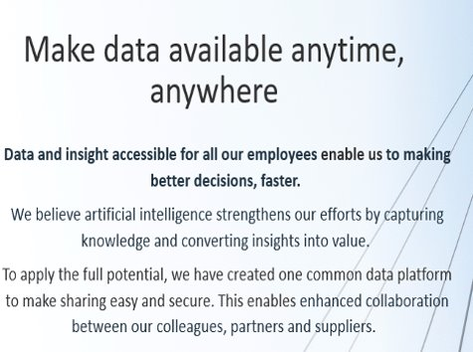
Drivers for OSDU
Boost innovation
Minimize data “locked” in functional silos
Interoperability
Digitalisation require data with known quality
Lack of lineage and provenance
Data needs curation to be valuable
Avoid information loss
Common catalogue and access to data
None can do it alone
Enable industrial automation
Sharing infrastructure development cost
Industrial standardisation
To address

Slide 6
The OSDU journey
2022 and beyond
Increased commercial solution focus: Cloud Service and app/solution providers.
Continuous development of new OSDU capabilities.
Seismic, Wells, Reservoir, Rock & Fluid, Production, Real-time, New Energy, ….
Initial operational deployments in many O&G companies.
Equinor, ExxonMobil, Shell, Chevron, TotalEnergie, BP, Petrobras, WinterShall DEA, …
2020-2021:
OSDU Mercury – development of first commercial release.
Implemented on Microsoft, AWS, Google and IBM/RedHat
2018-2019:
Shell invites O&G companies to join forces to drive the development of an Open Source Data Platform for Upstream O&G and donates Shell Data Universe (SDU) code as a kick start.
OSDU founded in September 2018 as an Open Group Forum. Many ISV’s and tech companies joins and new are still joining
July 2019: SLB donates DELFI data services. Refactoring Shell+SLB code really kicks-off.
– 2017:
Increased focus on digitalisation, data and new value from data
O&G cloud transition begins.

Slide 7
From platform development to solution integration – relative effort
Early days dominated by platform
As the platform become usable, a growing set of solutions emerge
Approaching inflection point where solution development overtake platform
Solution space development will change from creating point solutions to workflow composition and system integration
OSDU Data Platform
OSDU adaption and enabled business solutions
2019
2023

Slide 8
What is the OSDU Forum Creating?
The Core Software “Data Platform”
Data ingestion, storage, search, and consumption.
Open Source software with published APIs and Domain Data models
Support for versioning, lineage and provenance.
Hosted on agnostic cloud infrastructure
Available on Microsoft Azure, Amazon AWS, IBM, Google GCP and others
Can be hosted on internal IT infrastructure
“The OSDU Forum is creating the Data Platform and Documentation for the analysis of subsurface and related energy data”

Slide 9
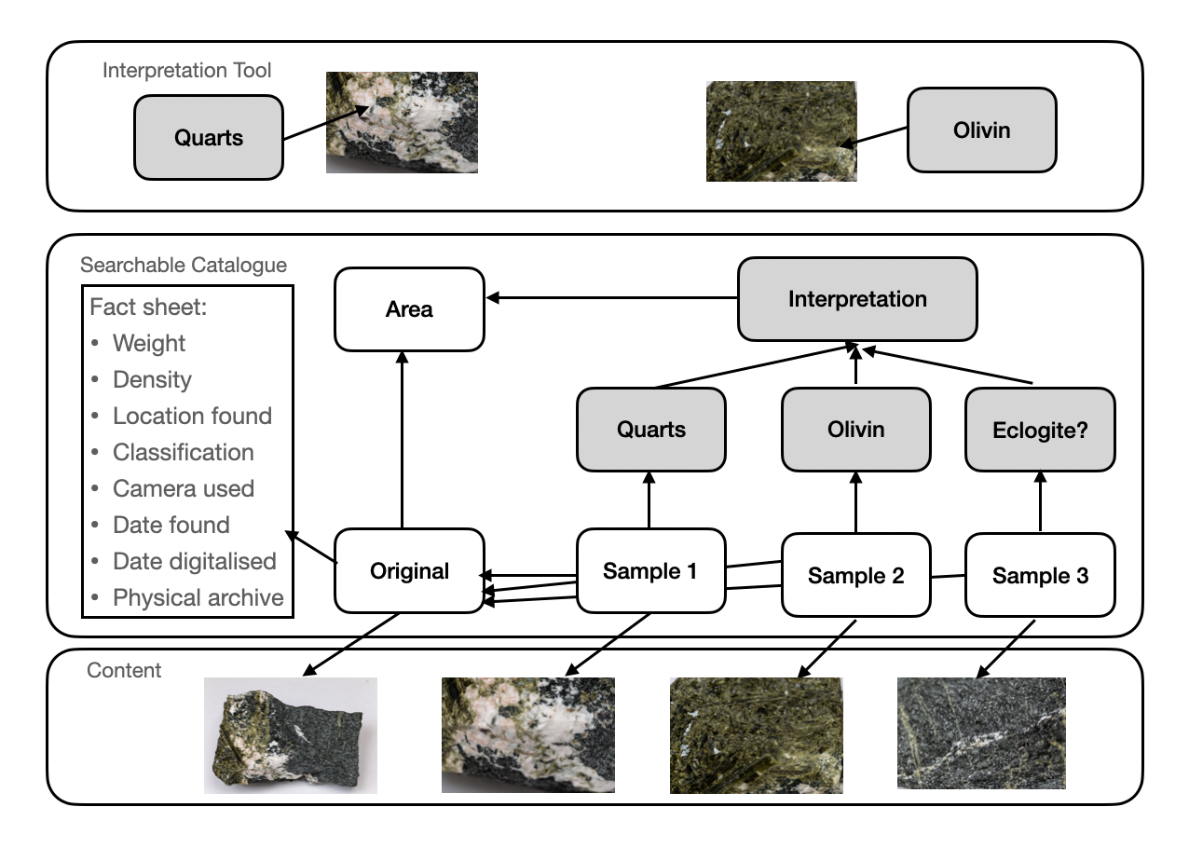


OSDU Data Platform Support for versioning, lineage and provenance is key capabilities
Users
Interpretations are judgements
Human reasoning can be captured
AI support if used also captured
Solution
space
API
Tool speaks with OSDU through API
Core API
Optimized domain APIs (DDMS) where applicable
OSDU provide data provenance by:
Linking samples to source
Linking interpretations to samples
Endgame: Reduced business uncertainty
Trustworthy interpretations
Trustworthy decisions (conclusion)
Insight into judgements
Data provenance
Improved interoperability from standardized schemas and APIs
From Einar Landre´s OSDU Blog
Part 1: https://osduforum.org/osdu-data-platform-primer-1/
Part 2: https://osduforum.org/the-osdu-data-platform-a-primer-2/

Slide 10
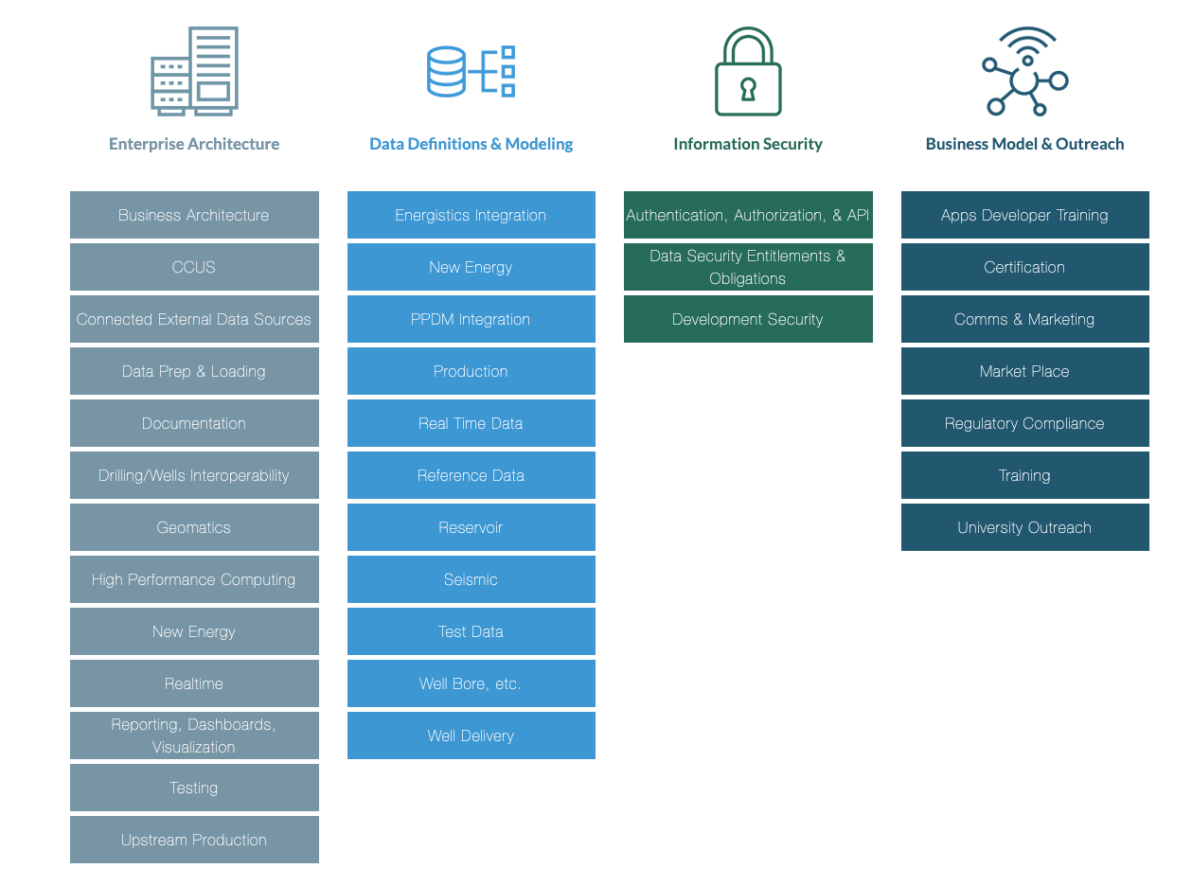
OSDU Working groups

Slide 11
What does it take?
OSDU Success =
Alignment, transparency and
co-operation
OSDU Community
Vendors
Equinor
Key observations:
There must be a joint situational perspective for the area to standardize.
There must be assumed business opportunities in several dimensions for this to work.
E.g. Operators, Service/SW providers and cloud providers.
Transparency and openness within forum is a make or break
Operators (as main customers) involvement and contributions in the OSDU community is key.
Equinor very active in OSDU Community.
OSDU Sponsors: Harald Laastad & Oddvar Vermedal
OSDU Advisory Group: Harald Laastad & Oddvar Vermedal
Equinor focal-point: Einar Landre
OSDU Management Committee: Equinor (Øivind Berggraf) ,TotalEnergie, Shell, BP, XON,
OSDU Chair: Chevron
5-10 resources continuously involved in different parts of community. Spans SMEs, Data engineers, SW architects and others from different parts of Equinor.
Operators like Equinor needs to have focus on developing the new market and from time to time seed fund application and service vendors.
OSDU is a key strategic bet in Equinor´s digitalization and cloud journey
Equinor have an internal OSDU DevOps team (8-10 persons) continuously working on utilising OSDU in Equinor.

Slide 12
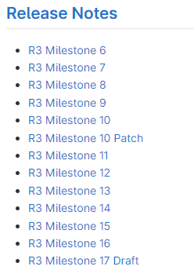
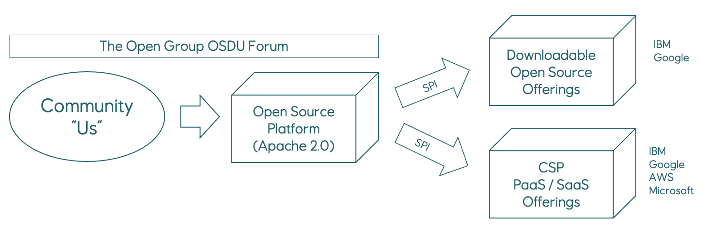
OSDU Community – a working delivery mechanism Development, Integration of community code, Test and deploy on several platforms
July , 2021.
12 deliveries in 20 months !
Velocity is a function of community contribution
March, 2022.

Slide 13
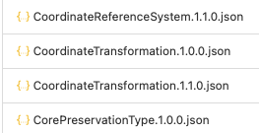
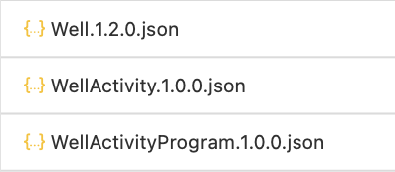
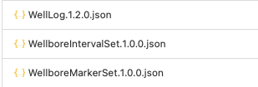
Supported and growing data types
+ 200 Reference Data Items
+ 60 Master Data Items
Endless list of Content
DLIS, LAS, WITSML, ..
SEGY, SEGD, OpenVDS, …..
JPG, PDF, ....
Named Streams, …
+ 100 Work Product Components
https://gitlab.opengroup.org/osdu/subcommittees/data-def/work-products/schema

Slide 14
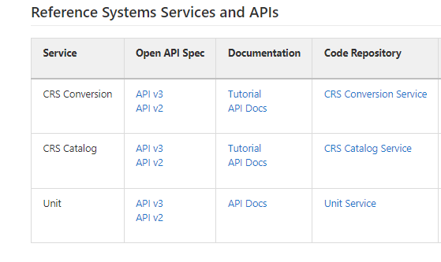
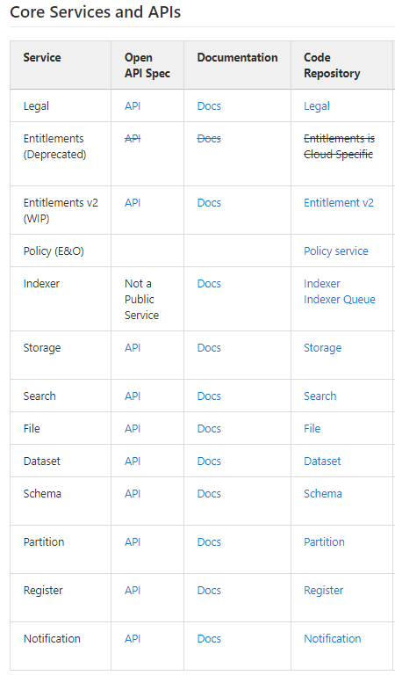
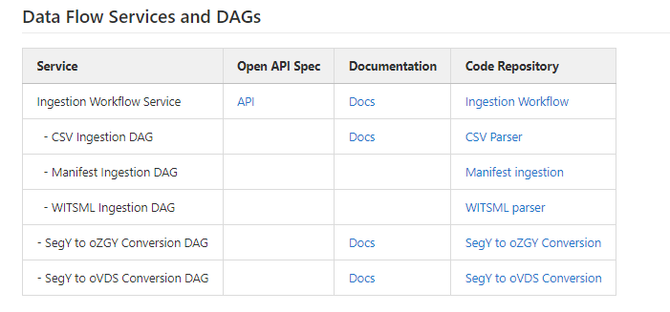
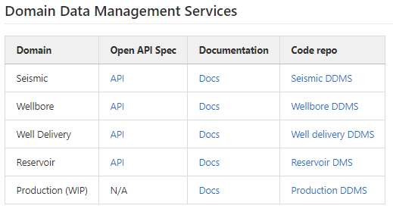
OSDU APIs
High level

Slide 15















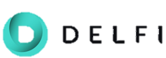








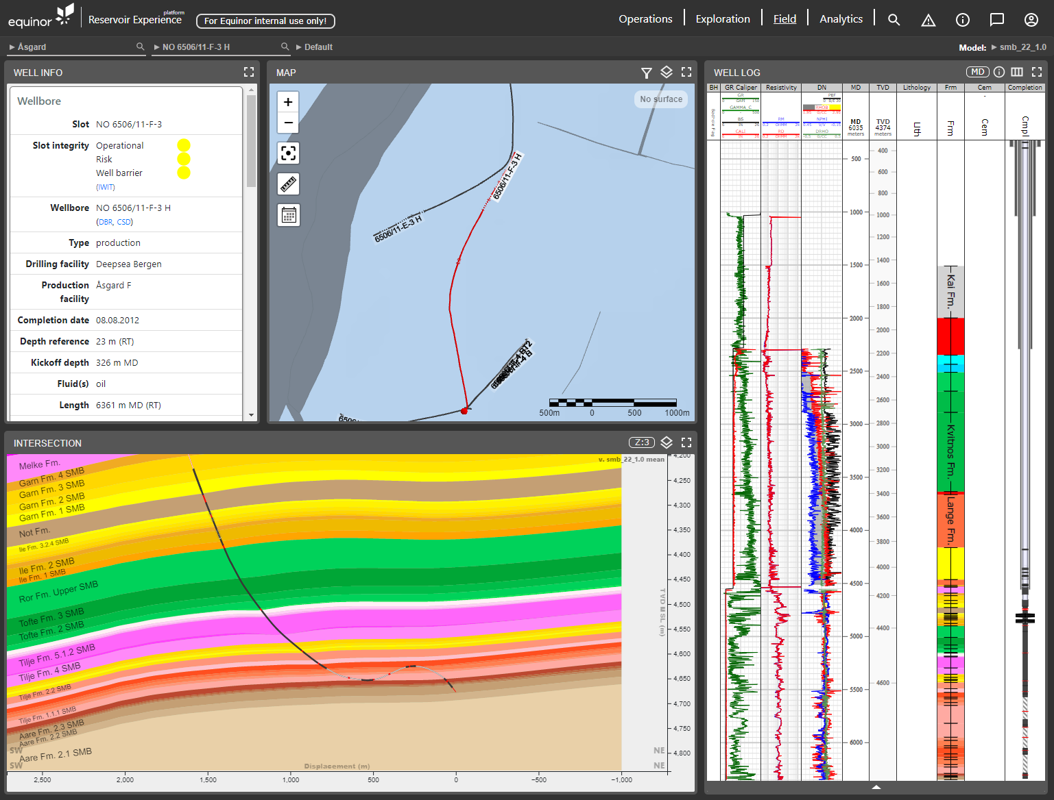
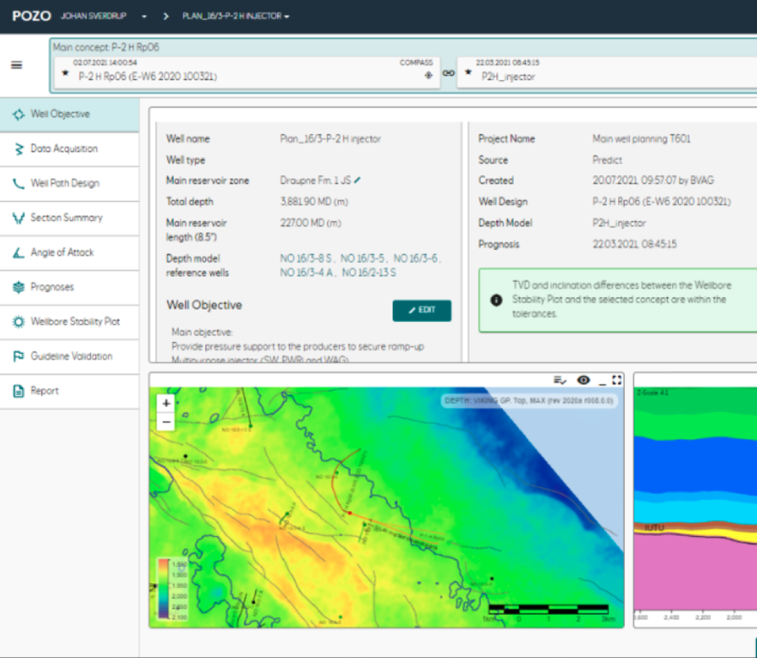
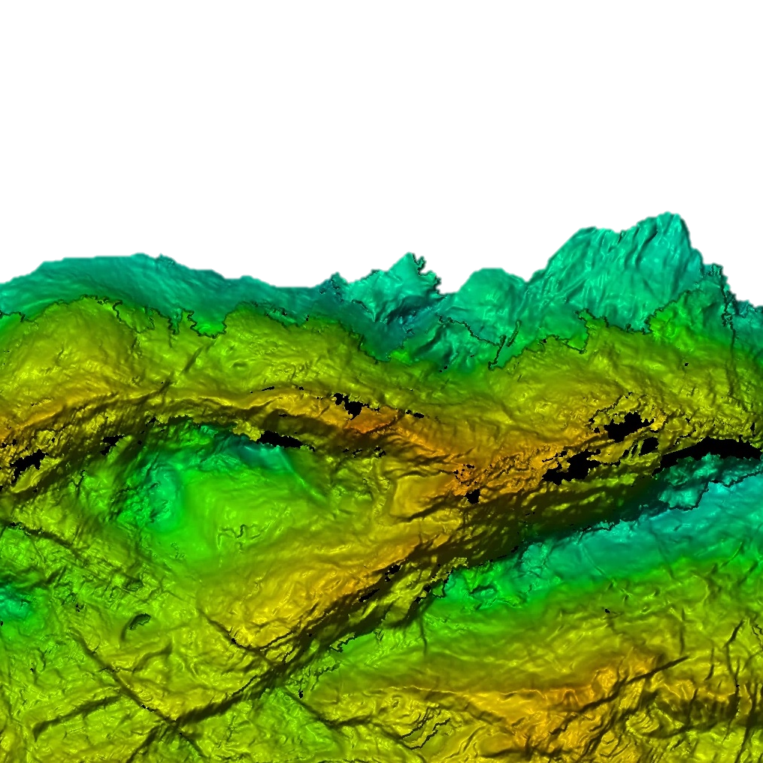


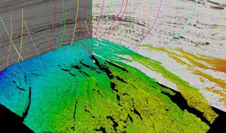
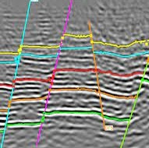
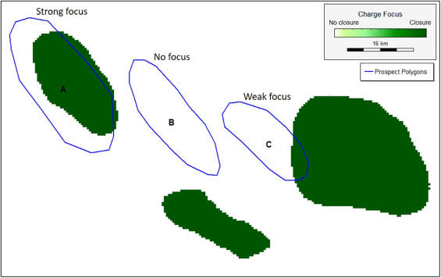
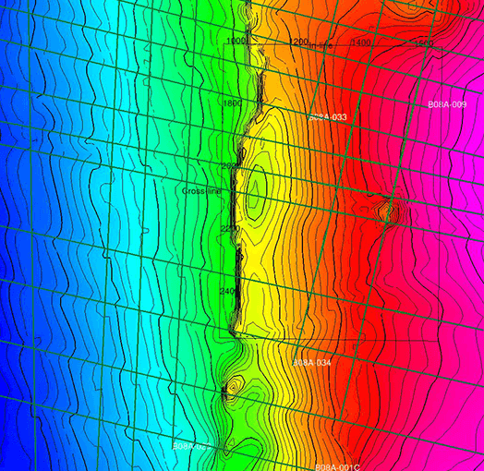
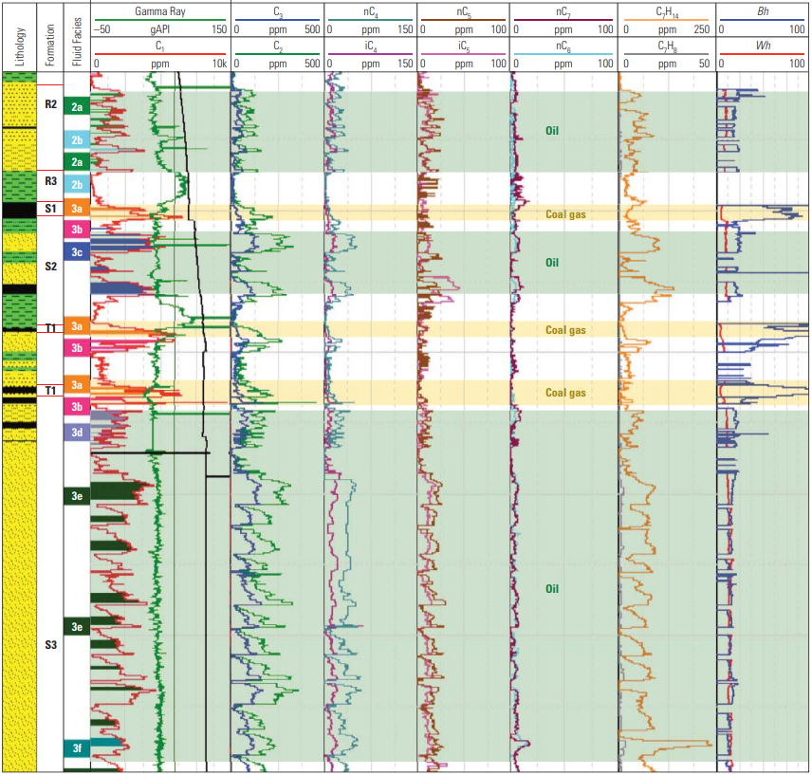
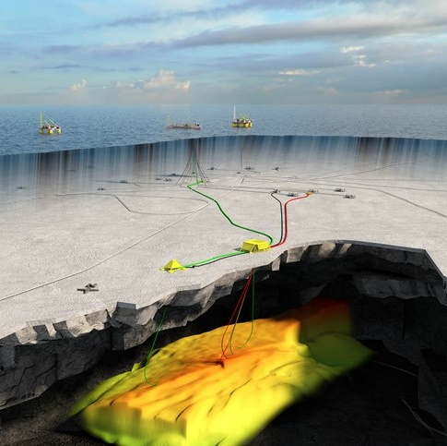
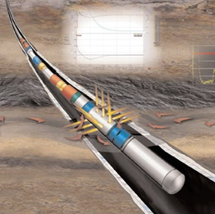

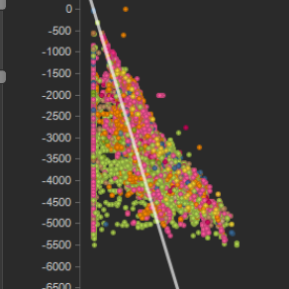
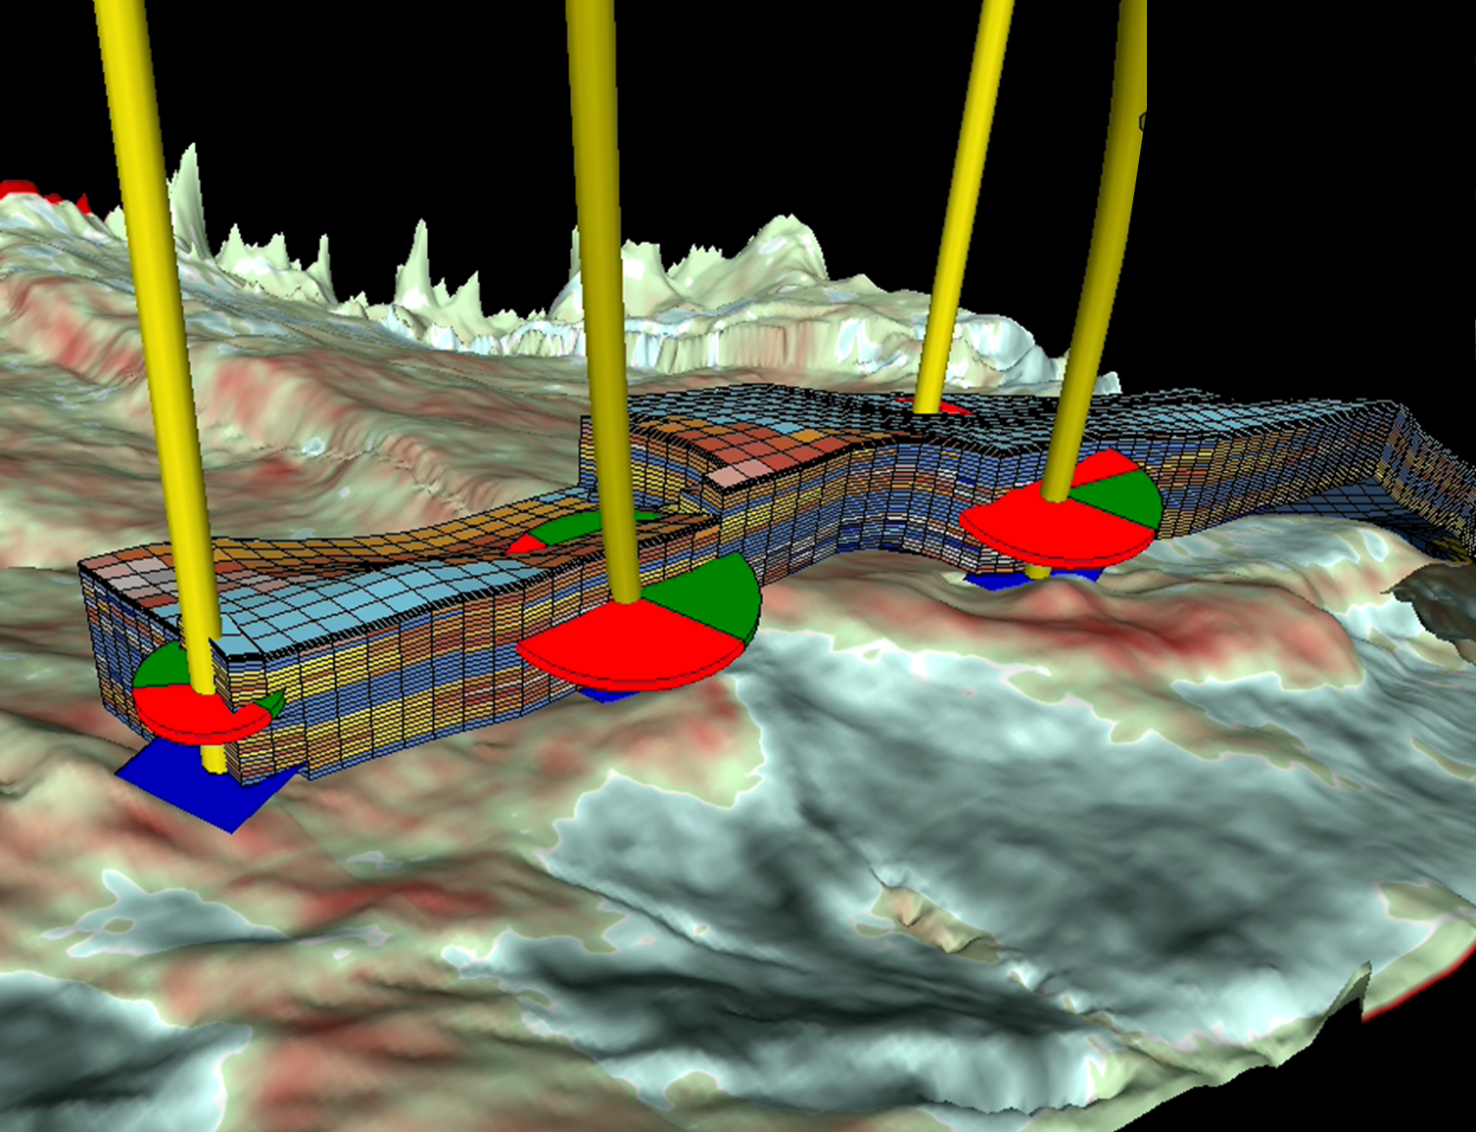

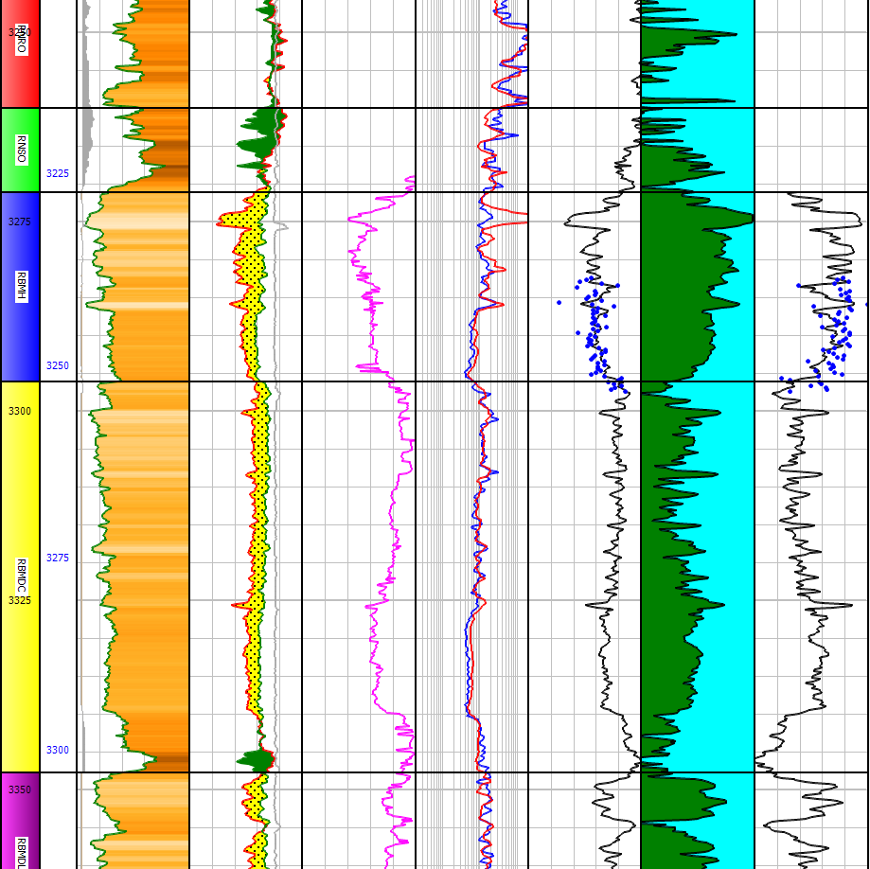
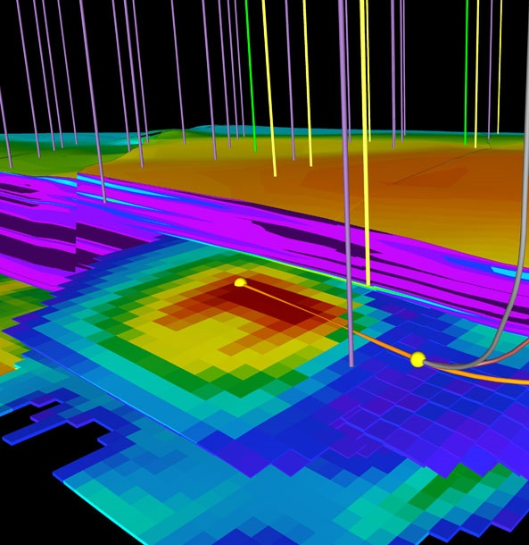
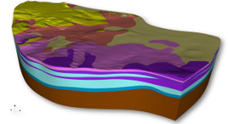
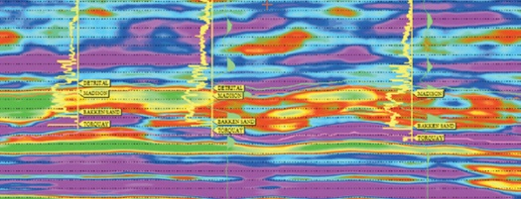
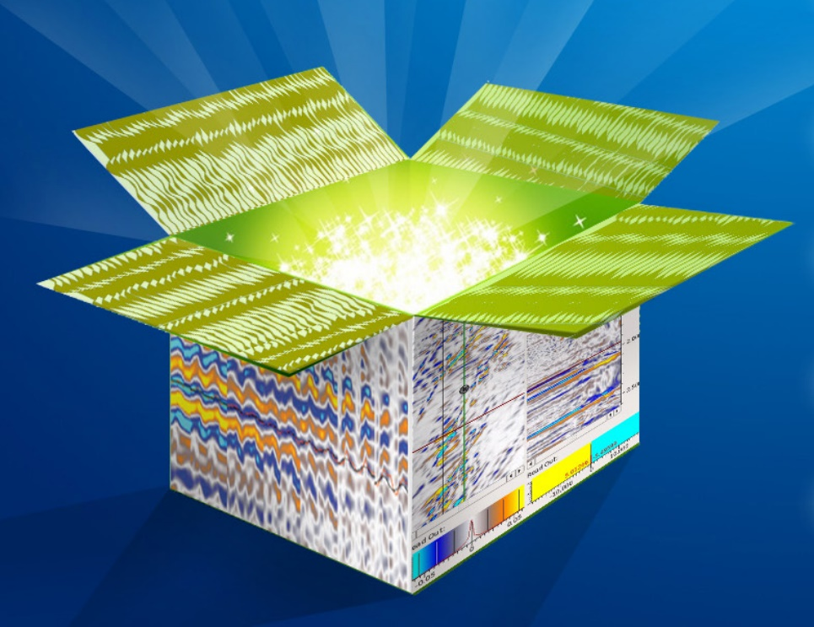
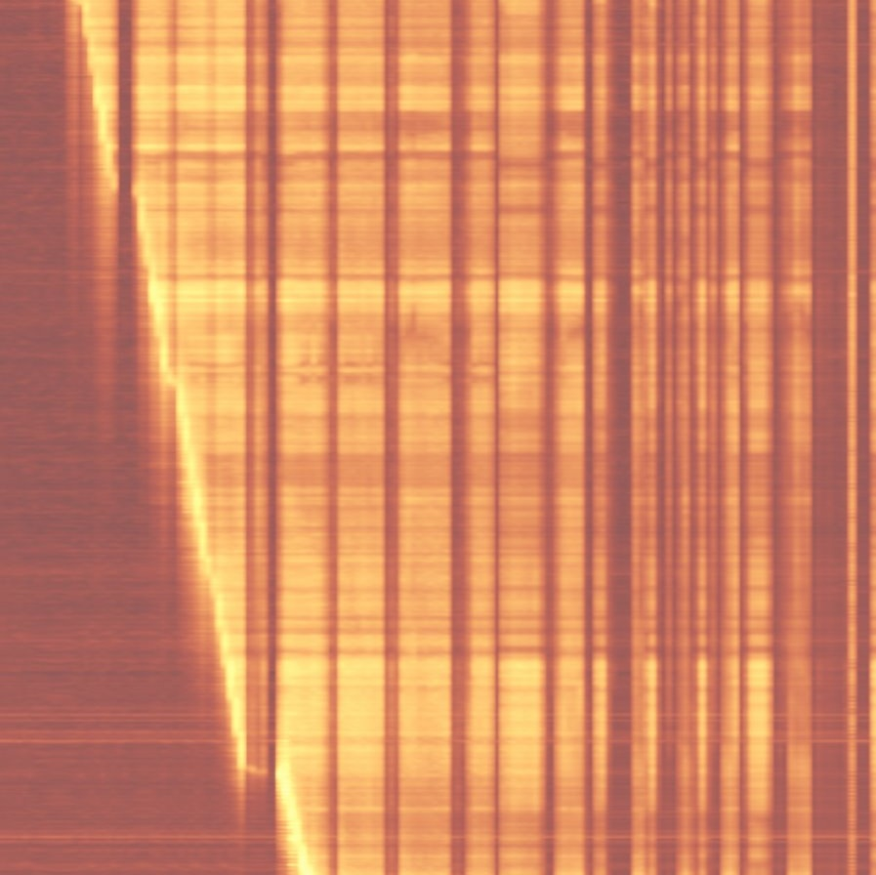

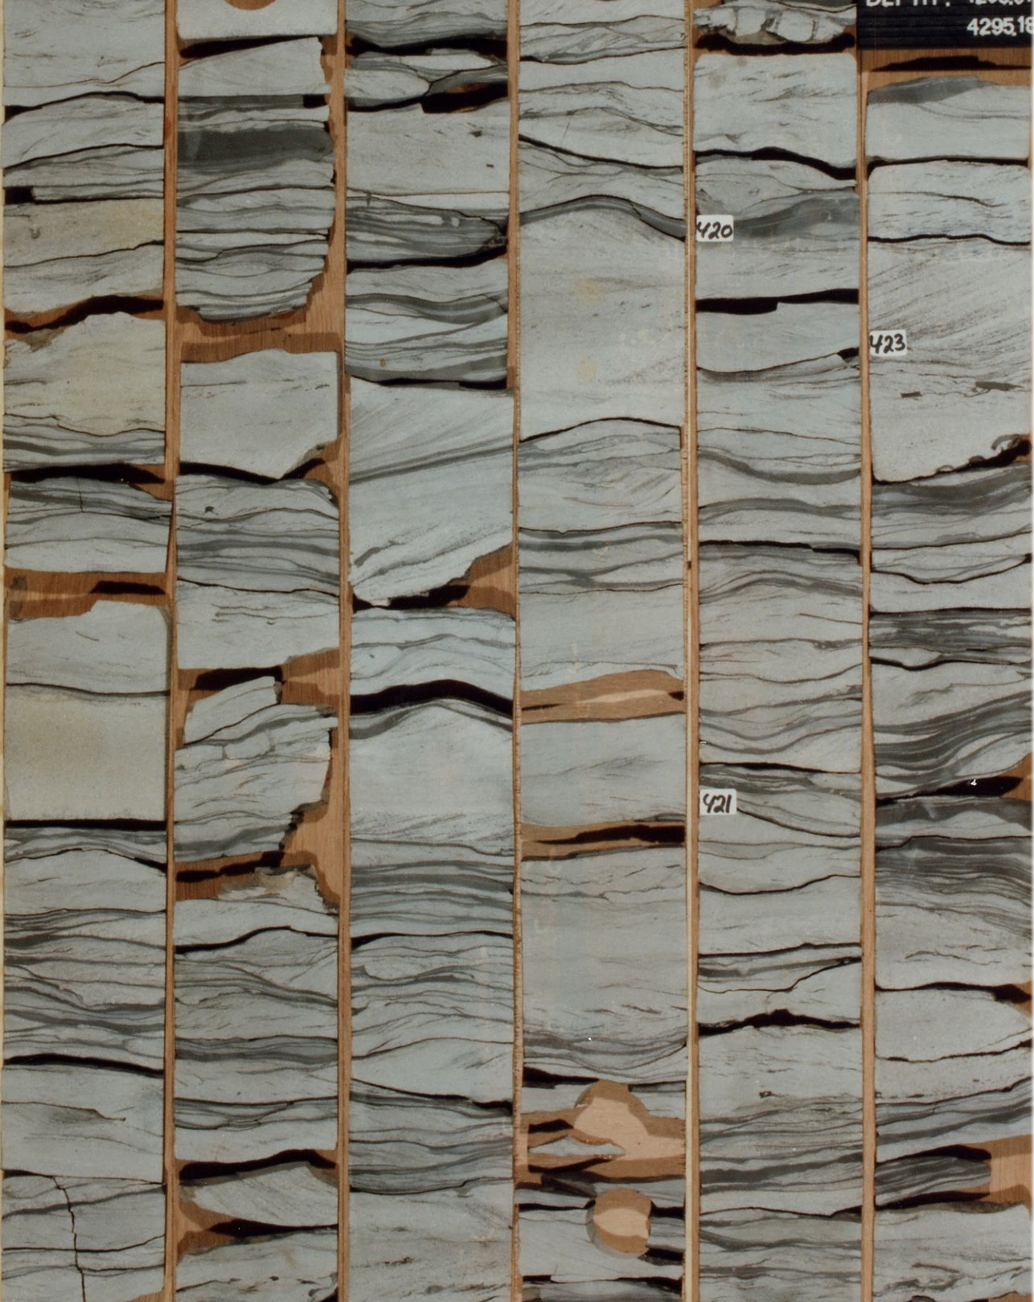

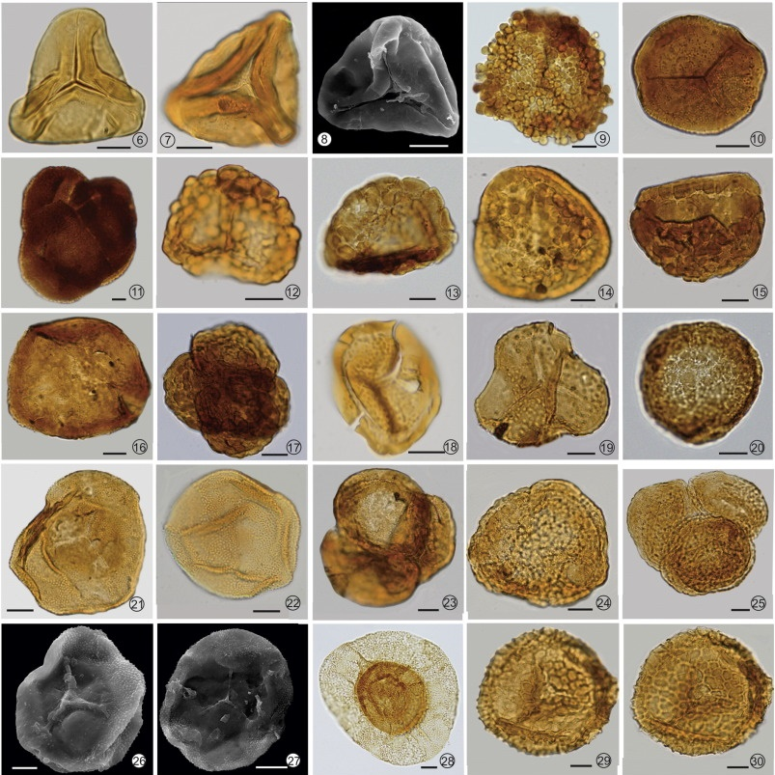
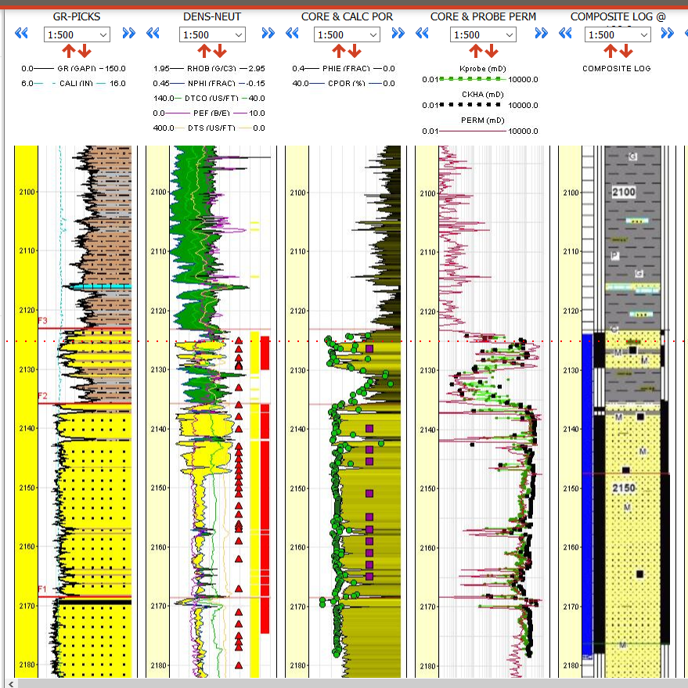
A leading company in the energy transition
Turning natural resources into energy for people and progress for society
Transforming the NCS to deliver sustainable value for decades
EPI Strategy - Focus on quality / portfolio high grading
Deliver positive cash flow every year even at
>$30 Billion
Internal rate of return
Annual maturation of new volumes from increased recover
Number of wells per year (Equinor operated)
Reduced well/ target cost
Reduced CO₂ emissions from production in 2030
Free Cashflow
20%
Operated projects
250 - 350
100 - 150
50%
50 USD/bbl
< 8 kg per boe
50%
mmboe
DG0 & DG3
Total number of wells
S C A L E
S P E E D
S I M P L I C I T Y
Balancing investments vs divestments
2021-2030 based on 60 USD per bbl
Based on 60 USD per bbl
Co2 Intensity
SUBSURFACE DIGITAL STRATEGY
TARGET
By 2027, at a minimum, all Norway assets will perform their subsurface work processes in cloud native applications with cloud-native data engineered for quality and accessibility.
To be a digitally literate subsurface organization - capable of predicting valuable outcomes faster and with better control of uncertainty - by using all relevant data and experiences - along with analytics tools and methods in our subsurface work processes.
VISION
RESERVOIR ENGINEER
PRODUCTION ENGINEER
DRILLING ENGINEER
PETROPHYSCIST
DATA SCIENTIST
GEOPHYSICIST
GEOLOGIST
RMS
GEOLOG
Bravos
REP
POZO
DELI
GeochemDB
PressureDB
Horizons
Faults
Polygons
Grids
Wellbore Data
D&W Data
Well Plans
Prod Data
DISKOS
CoreDB
BiostratDB
Well Picks
Well Targets
Geomodels
Attributes
Seismic Data
Fibre Optics
Master Data
PVT
FMB

Slide 16
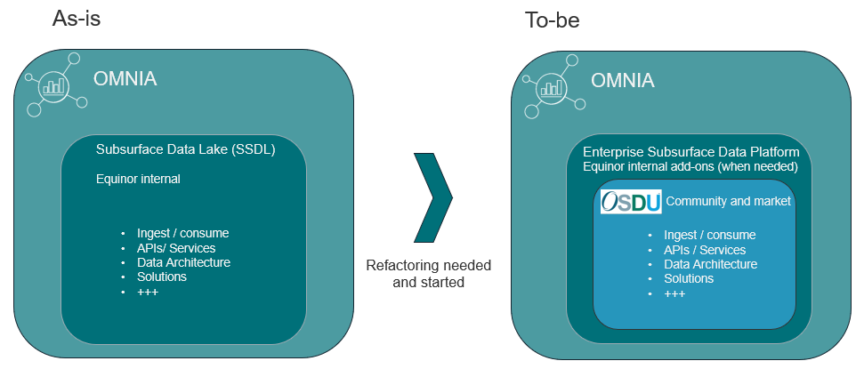
Cloud journey - OMNIA & OSDU
OMNIA goals
Increased innovation based on availability of “all” data. No data silos.
Faster feedback cycles and return on investment for innovations
Increased speed of implementations driven by having data more easily available through an enterprise data platform.
What does OSDU bring to the table
More efficient cooperation with and use of external market and communities.
Improved interoperability.
Giving us the ability to optimize Equinor bespoke solutions patterns, data products and APIs to where it really counts.
Accelerate use of standards and Open Source - key part of Equinor IT strategy.

Slide 17

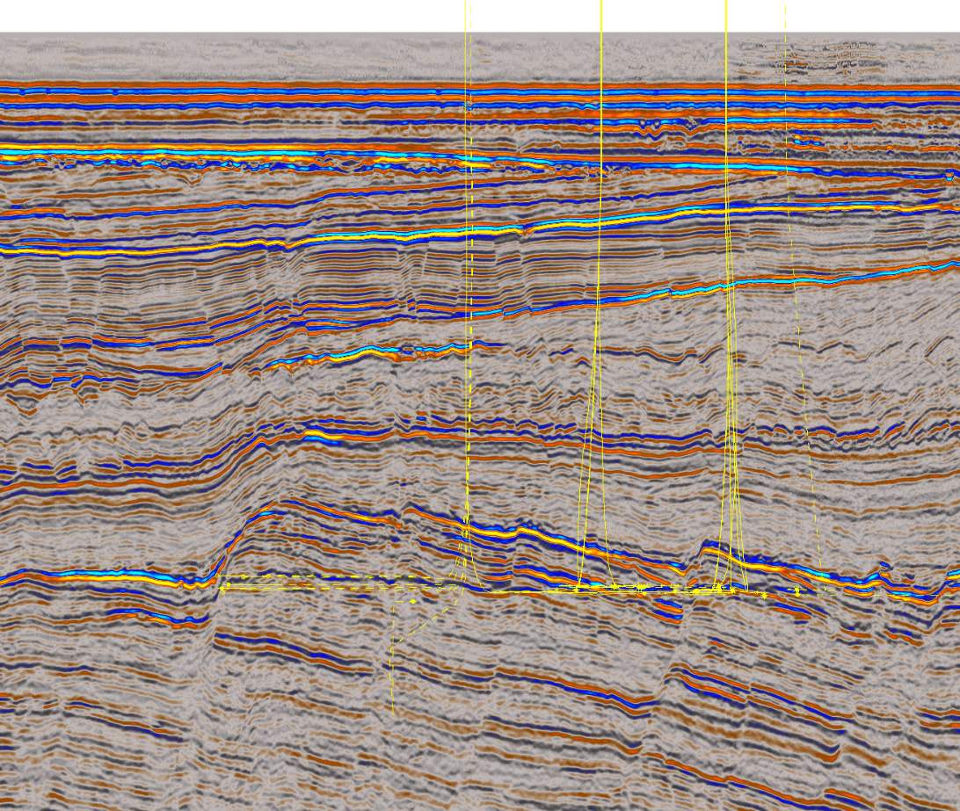




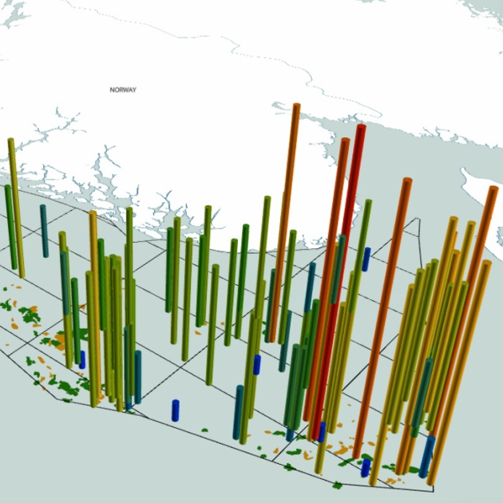






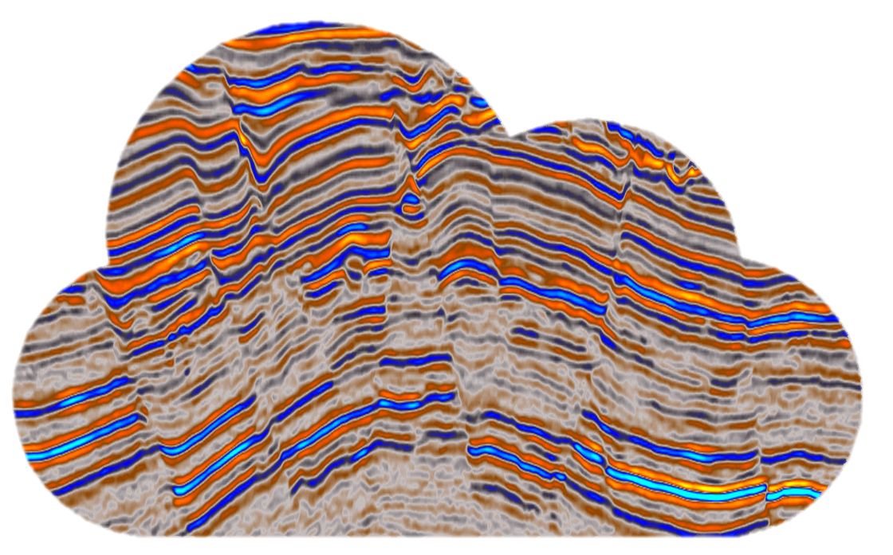




2
Use cases in Equinor
02
Terrastor
4
04
Well Data Availability
1
Seismic Data
Index & Search
01
3
03
platform
5
Reservoir Experience
05
Vendor N
Testing Interoperability
Testing external
Cloud-native solutions
OSDU connection
to internal apps

Slide 18

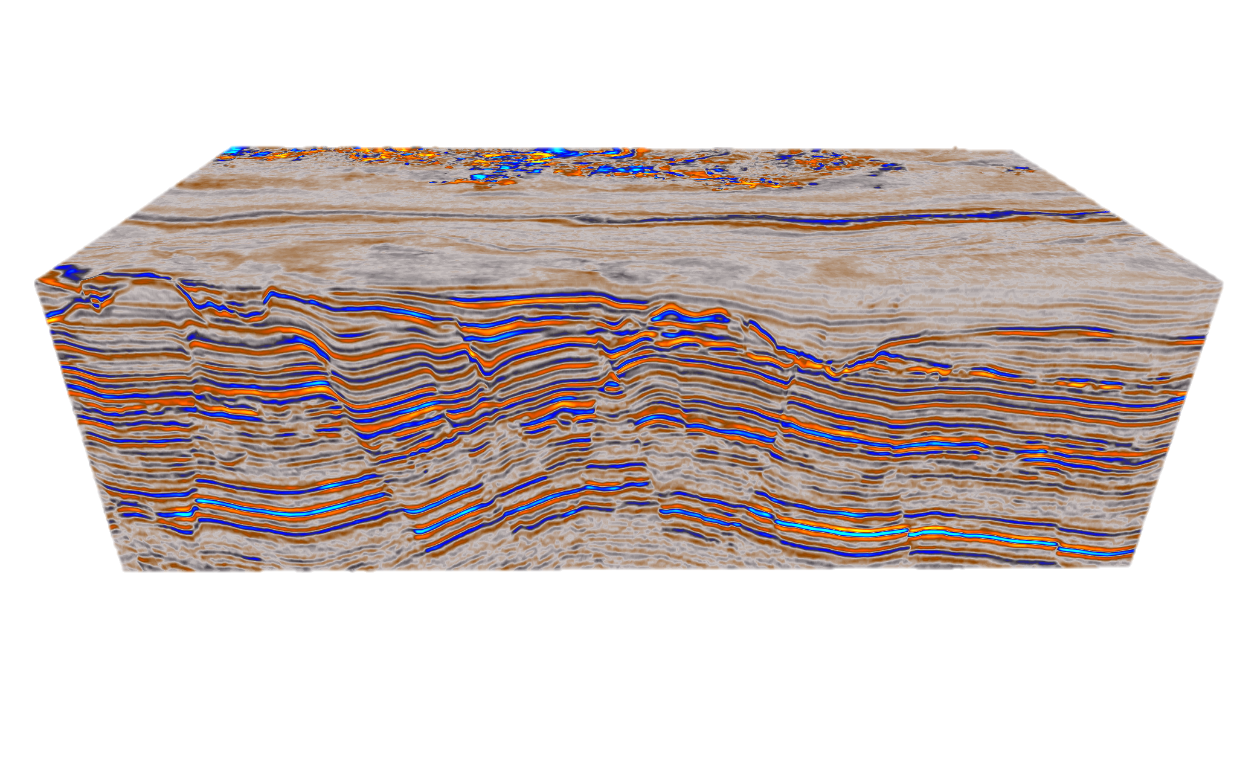






1
01
Testing Interoperability
Goal: Achieve interoperability between our main Seismic Interpretation tools
As a user, I no longer need to perform cumbersome import and export routines, and I can easily pick and choose applications with seamless interaction. I spend more time on value-adding activties

Slide 19











2
02
Seismic Data Index & Search
Goal: Enable efficient search and retrieval of Seismic Data,
By focusing on extracting, enriching and improving consistency of metadata
As a Seismic Interpreter, I can choose the data which is most suitable for my task and better understand the quality. We can make better decisions whether to buy new data or reprocess
SEISMIC DATA BANK
Terrastor
OPENWORKS
STUDIO
EQUINOR DATA STORES
MULTI-CLIENT DATA STORES

Slide 20
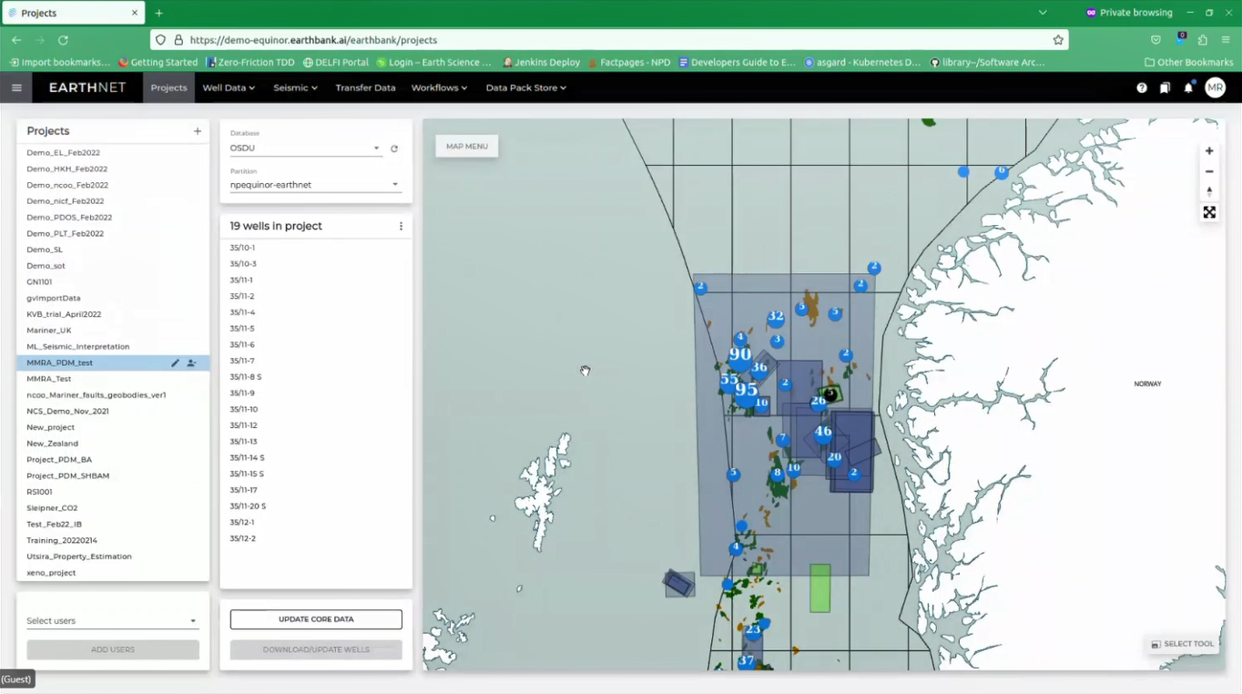
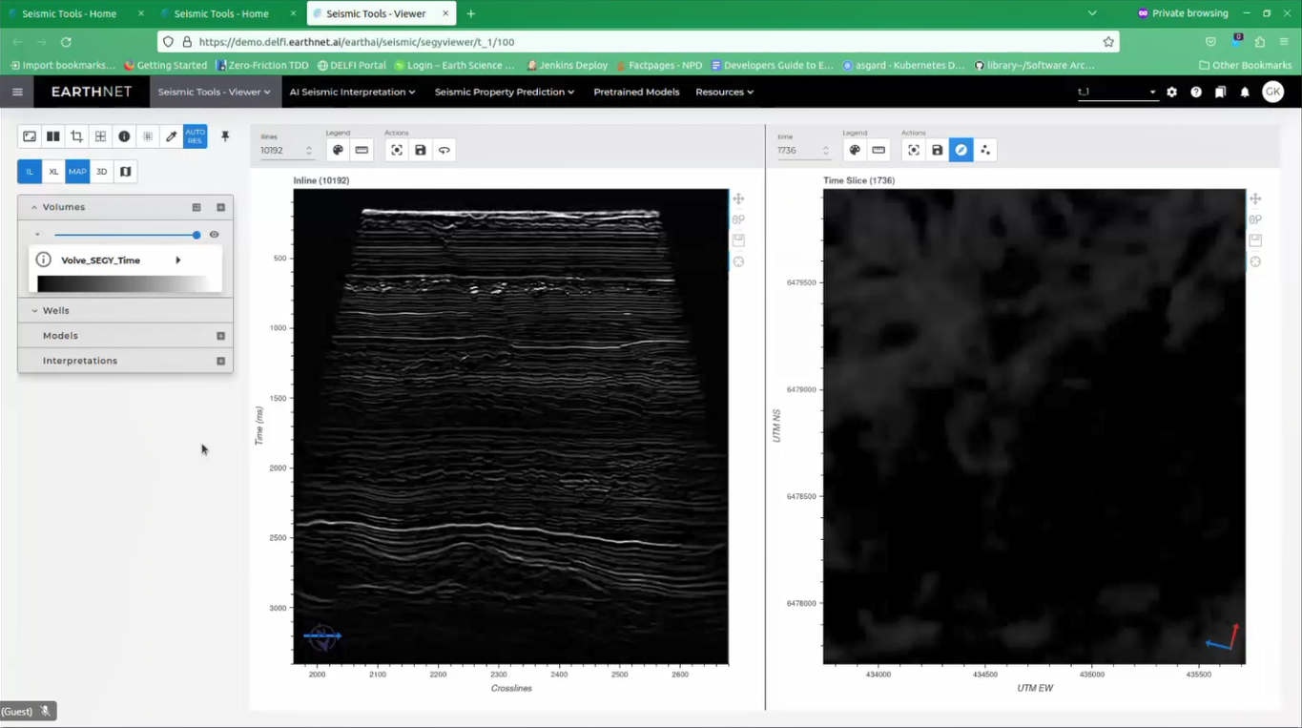
3
03
Testing Cloud-Native Solutions
Goal: Investigate new Cloud-Native solutions that we can deploy and connect to OSDU that will enable new ways of working/automation/efficiency
As a user, I can access new applications that can provide me with specialist functionality not existing in my current tools (i.e Machine Learning, advanced querying) . Getting data in and out of the application is seamless and requires no manual work

Slide 21


4
04
Well Log Data Engineering workflow
Goal: Make Well Log data available - enriching data and automatically create well log composites
As a user, I can now search, access and consume all Well Log Data within applications or for analytics, Automated Well Log Composites save 250+ years of Petrophysicists time
Standard Curves
Mud Gas Curves
Drilling Curves
Positioning
Geomech.
DT
C1 out
C2 out
TG out
Mud Flow In
ROP
WOB
TORQ
AZIMUTH
INCL
PR
YM
CALI
GR
RHOB
NPHI
DEPTH
Asset requests
.txt
.ascii
.las
.dlis
.lis
RAW WELL LOG FILES INGESTED INTO OSDU, CRACKED UP AND COMPILED (SPLICED)

Slide 22


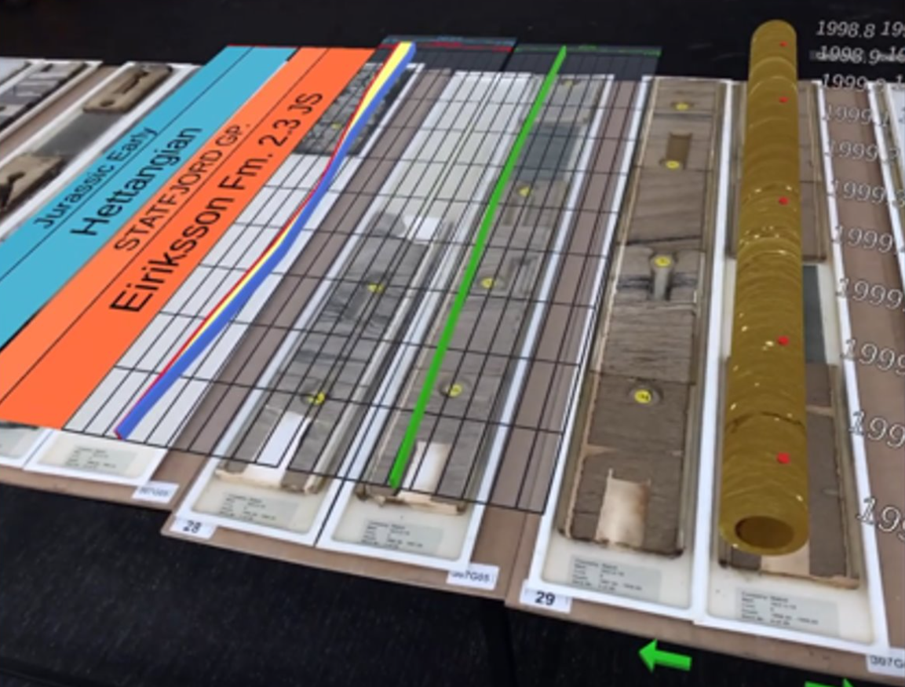



5
05
OSDU connection to internal apps
Goal: Utilise OSDU as a landing zone for internal apps
As a user, I am now able to pick and choose applications, both external and internal like an App Store on my iPhone, enabled by the seamless flow of data
BRAVOS
platform
Reservoir Experience
POZO
Rock’n’Log
Pre Salt
Analytics
Cuillin
DELI
DynaGeo
Tool for efficient well planning
Cloud-native Visualisation of Core data
Deep learning for Seismic Interpretation
Data visualization for res characterisation
Efficient data visualization
Digitalisation of cuttings data

Slide 23














Peer status and plans as presented in OSDU Forum
It’s big and it’s complicated...but... the upside is huge.
PoC phase is done ... We are on the journey. This is doable (but not easy).
Expertise of Forum members is truly impressive: The answers are in the room.
Fully committed to OSDU
4D seismic to simulation use case
Rock and Fluid focus and development
Improved context enables trust :
OSDU technical assurance, data lineage, & metadata capability will provide this.
Moving to production and scaling up
One central catalogue to find all data
Lineage and provenance for data.
Quality and assured metadata
Operational well preparation, well operations and post-drilling solution based on OSDU in Tilenga asset/Uganda.
Committed and working on how to start migrating initial solutions and work-flows onto OSDU in 2023.​
High impact use cases are well planning and reservoir modelling
OSDU Data Platform enables data to become a product that teams share rather than collect and silo.
PVT data solution operational on OSDU
Working on Rock & Fluids..

Slide 24
Main take-aways
OSDU is now in early operations in Equinor – available as PaaS service from the main cloud service providers
Equinor is a front-runner – Interoperability sandbox - internal dev team – community contribution
OSDU is a cultural “revolution” – as we go from buying to contributing – becoming ”prosumers”
OSDU is not a destination – it’s a journey and will requires continuous experimentation as we move forward
OSDU is not bound to subsurface and drilling, but that was where we decided to start

Slide 25
Equinor OSDU Goals for 2023
OSDU operational within OMNIA on Azure Data Management Services (ADME).
Value realisation by providing data to and storing data for several business initiatives and solutions.
Scalable frameworks and solutions in place for data ingestion and consumption related to OSDU
First cut for OSDU as an interoperability mechanism for business workflows.
Today
2022
Q1
Q2
Q3
2023
Q1
Q2
Q3
2024
OSDU Community – Continued Equinor participation and work
TDI focus.
Platform, operations, data and governance.
EQN OSDU Maturation - POC/Pilots
EQN OSDU grow data coverage/quality and operational hardening (many initiatives)
…
OSDU in “soft” production within OMNIA
Microsoft OSDU/ADME PaaS official release
Microsoft OSDU/ADME PaaS early release
OSDU operational within OMNIA.
Operational EQN Enterprise OSDU platform within OMNIA
EQN OSDU cloud native workflow and interoperability pilots
…
EPI/EPN/D&W focus.
Application, solutions and workflows.
EQN OSDU Interop Sandbox
EQN Establish test/scouting env for OSDU solutions
EQN D&W onboarding/POCs
OSDU in OMNIA - operational readiness:
POC/Pilot ready
Soft production
Fully Operational
Best effort SLAs and KPIs
Initial operational governance
Performance and scalability in maturation
Disaster recovery and backup. As needed, but limited.
Agreed SLAs and KPIs
Operational governance in place (Internal/External)
Performance and scalability matured.
Disaster recovery and backup

Slide 26
The end – questions ?

Slide 27
OSDU Ecosystem

Slide 28



OSDU Introduction USING AN IPHONE AS THE ANALOGY
Two examples of iPhone
Interoperability
OSDU will enable Interoperability in Subsurface tools:
Enabling photo sharing across all applications
Enabling efficient data flow across applications, so people no longer need to do cumbersome and manual import and exports
All health & fitness information automatically available from multiple apps
All data and tools available in one place, helping with collaboration and efficiency
Only possible due to standardization - iOS ShareSheet, BlueTooth, WiFi, Photo/Video Formats (JPEG, MP4, HEIF and general metadata standards) HealthKit (HL7, CDA) HomeKit (HAP, SSDP, UPnP), XML, JSON
Only possible due to Standardisation! Including RESQML, WITSML, PRODML, PPDM, OpenVDS, OpenZGY, JSON +++
Leading to widespread innovation and new business models
Leading to widespread innovation and new business models related to Subsurface

Slide 29

OSDU Data Platform Support for versioning, lineage and provenance is key
OSDU provide data provenance by:
Linking samples to source
Linking interpretations to samples

Slide 30
OSDU, data liberation and solutions High level technical journey and vision
«Cloud native»
EQN tenant
OMNIA classic (Lift & shift)
EQN tenant
OMNIA standalone
“cloud native”
Vendor tenant(s)
“cloud native”
Transitional state for x years?
App1
If needed and possible
End-goal
End-goal
App2
API Gateway
App3
Vendors and internal
“cloud native apps”
SaaS Solutions
On premise - EQN
Move:
On going
Now
Improvements where “possible”
App1
Data flow
App2
Challenge:
How to transform
and coexist during transformation
App3
Vision, strategy and priority1 where possible
Vision, strategy and priority1 where possible
Vision, strategy and priority1 where possible
EQN tenant
OMNIA standalone
“cloud native”
Transitional state + End-goal
= Equinor on-prem data centre(s)
SMDA
OMNIA - Equinor Enterprise Data Platform
The target data platform for liberating Equinor data from application specific silos.
= Equinor cloud tenants
SDB
PDM
= Vendor cloud tenants
Others

Slide 31




OSDU / Status in EQN Data in Equinor OMNIA/OSDU instance
Quality assured Equinor master data from SMDA (Equinor Master Data Store for Sub data)
Fields, Wells, Wellbores etc.
Utilizing many reference data as provided by OSDU
Equinor Geodetic catalogue and CRS transformations in place. In close cooperation with Equinor Geodetic specialists.
Working on Equinor Master Curve List. In close cooperation with Equinor specialists.
Well data:
Quality assured composite well log + raw well log data. Close cooperation with EPI Data Fundamentals group
50 000 Wells, 60 000 Wellbores, 1 million well logs.
Seismic - the interoperability pilot
Cubes up to 500 GB – stored and streamed (no copying) using OpenVDS and/or OpenZGY directly to several applications
For example (approx. 600 GB)
Horizons and Reservoir - the interoperability pilot
Visualising grid interpretation with 217 million gridnodes
Sharing surfaces between vendor-applications through OSDU
Seismic databanks:
Starting to work on how to connect OSDU to seismic databanks. E.g. Equinor SDB, DISKOS and other.
Initial plan: Making data discoverable from OSDU with link to bulk data in databanks. Copy bulk data into OSDU on demand
“Unstructured” data: Working on the full WellDB.
Currently 20 million files in OSDU Dev.

Slide 32



Examples from Equinor
Some sample slices generated from Python reading the seismic from OSDU.
Same OSDU source and access mechanism as used by SLB and HAL in Interop POC
CGG18002-NVG-SOUTH-FINAL-KI-PRESDM-Z-FULLSTACK survey
Sample version of OSDU well data in REP (ongoing work)

Slide 33
OSDU, data liberation and solutions High level technical journey and vision
«Cloud native»
EQN tenant
OMNIA classic (Lift & shift)
EQN tenant
OMNIA standalone
“cloud native”
Vendor tenant(s)
“cloud native”
Transitional state for x years?
App1
If needed and possible
End-goal
End-goal
App2
API Gateway
App3
Vendors and internal
“cloud native apps”
SaaS Solutions
On premise - EQN
Move:
On going
Now
Improvements where “possible”
App1
Data flow
App2
Challenge:
How to transform
and coexist during transformation
App3
Vision, strategy and priority1 where possible
Vision, strategy and priority1 where possible
Vision, strategy and priority1 where possible
EQN tenant
OMNIA standalone
“cloud native”
Transitional state + End-goal
= Equinor on-prem data centre(s)
SMDA
OMNIA - Equinor Enterprise Data Platform
The target data platform for liberating Equinor data from application specific silos.
= Equinor cloud tenants
SDB
PDM
= Vendor cloud tenants
Others

Slide 34
Input
Data flow - Aggregation
Deliverables
Petrel Studio
Structured info
Horizon interpretation
Horizon and fault confidence and uncertainty evaluation
Petrel
Input to surface and target location
Pressure DB
Well tops
Wellcom
Petrel project
Pressure data
Risks
Project risks & timeline
Wellcom project
DBR (Stress atlas & LOT atlas)
Temperature prognoses / Formation tops and depth recalibrated for geological prognosis
Rock mechanic data
O365-Excel
Pore pressure prognosis
Predict project
Compass
Wellbore trajectory / survey
Wellbore logs
Predict
Pressure data
Pore pressure prognosis
Fluid and temperature data
Gravitas well manager
Drilling related incidents
Final well report
Pore pressure prognosis
Qced Geoprognosis and prerisk chart
Well DB
Well tops from Shallow hazard analysis
Permeability
Lithology
HRH Gravitas
Apx memo
Permeability
Well tops from Shallow hazard analysis
Drillbench project
Column height mdoel
QC’ed geoprognosis and prerisk chart
Investigate reservoir target drivers
Temperature prognoses
Blowout calculations
Documentum
Compiled Relevant and ready information
Pore pressure and wellbore stability plots
Geological basis for well design
Fluid, Temperature, Pressure and Drilling related incidents from well reports – wellbore logs & reference well info
Pore pressure and wellbore stability / Geoprognosis and prerisk chart
O365-Sharepoint (well)
Internal reports
Temperature prognoses
doc which can affect strategy and well objectives – offset well report
Unstructured info
Shallow hazard analysis
Porosity, HC column height, phase (gas, oil), drainage area from prepare well report
O365-Word
Area/exploration strategy from APx
Permeability
GEOX
Kick-off presentation
QA presentation to WPE
Location-specific reservoir distribution and quality
Prepare well report (PWR) & final geological prognosis
Pg, Pc, volumetrics, …
O365-Powerpoint
QA/QC report
Kick-off presentation
EXP well strategy and objectives
Simulation results
BO calc for env. Risk assessment
O365-Sharepoint (well planning D&W/WPE/Project)
G drive
License agreement
Kick-off presentation
Blowout calculations
define well project scope (integration between well planning group & license)
Concept selection report
Fluid data
PWR
Final geological prognosis
O365- Sharepoint (License asset)
Prepare well report (PWR)
Drillbench/Olga
Final geological prognosis
Porosity, HC column height, phase (gas, oil), drainage area from prepare well report
QC blow out and kill report
Outlook
Depleted BO rates and FBHP QA/QC
BO calc
Official report
Prosper
IPR+VLP (rates),FBHP
Predict project
Pore pressure Prognoses
Geological Prognoses
BO
Official report
Documentum
Gravitas well manager
Temperature Prognoses
Fluid data
Properties
QC’ed geoprognosis and prerisk chart
well strategy and objectives
Reservoir volume and paraneters – Initial BO rate
Adobe Acrobat
L2S (license to share)
IPR+VLP (rates),FBHP
Depletion modeling
PVT DB
Fluid data
PVT sim
GAP
MBAL
Depletion modeling

Slide 35

OSDU Interoperability sandbox Nov 2022 – Feb 2023
Demonstrate OSDU data flow and tool interoperability through testing a few cross-cutting geo science workflows spanning cloud versions of Petrel, DSG and selected data science tools.
Sandbox collaboration between Equinor, Microsoft, Halliburton Landmark and SLB
Selected seismic interpretation use cases
Aim for automated interoperability and data flows.
Validate that data is usable for general data science workflows outside commercial tools .
Sandbox will be a joint setup spanning cloud environment of all participating companies.
Vendor A
Vendor N
Can we enable seamless data flow across our key tools?
Begin with MS, SLB and HLB, others to follow in 2023

Slide 36
OSDU Interoperability sandbox STATUS AND CURRENT FINDINGS
February 1st, 2023, deliveries
Stream Seismic from Equinor OSDU/MEDS into iEnergy and DELFI
01
Plan including timelines for sharing seismic interpretation data through OSDU/MEDS
03
Share test results to steer OSDU community developments
04
Demo basic functionality for seismic interpretation workflows on OSDU/MEDS
02
Technology is mature enough to start implementation of applications
More focus from application and data teams required
Mutual dependency with our partners on testing to achieve desired results fast enough to reach our cloud native NCS ambition
Vendor A
Vendor N
Can we enable seamless data flow across our key tools?

Slide 37

The one less traveled
Many efforts at standards in our industry… not all successful
We must recognize that agreement is only the first step, and adoption is the harder journey…
Adoption requires changing the ways we work to break down silos..
Which makes the OSDU™ Forum different…

Slide 38
The OSDU™ Forum
The Mission
The Members
The Open Group OSDU Forum delivers an open-source, standards-based, technology-agnostic data platform for the energy industry that:
stimulates innovation,
industrialises data management, and
reduces time to market for new solutions
The OSDU Forum currently has 220+ Member Companies with a diverse set of goals and objectives:
Energy operators
Software & technology companies
Service companies
Research organizations
Academia
And more…
OSDU Mission & Vision – The Open Group OSDU™ Forum (osduforum.org)
Current Members | The Open Group Website

Slide 39

The importance of lineage and provenance Knowledge and intent is often lost along the “delivery” process
Fragmented delivery processes
Stove piped applications
Lost learning
Manual data transfers
Proprietary information models
Incoherent logical model
Finding
Ranking
Planning
Making
Learning
Learning is not piggy-backed and institutionalized for future use

Slide 40


Data Engineering for Well log analytics. An internal OSDU use-cases worked on within Equinor
Well Files
Well Files
Well Files
Use case info
Goal and iterations
Raw dataset
32 million files considered (cloud-lifted)
1 million raw files cracked
Step 2 - Raw dataset:
Ingest and store selected data in OSDU standard and/or custom schemas.
Register lineage between “Result data” and “Raw data”.
Data available for “any” user/workflow through OSDU APIs.
Data engineering and processing
2 days of processing (30 nodes@32GB memory each)
250 man years to do the job
Processing rules digitally documented (JSON) pr composite
Data Engineering
Data selection, context setting, Frame of Reference,
curve selector/splice, QAQC etc.
Step 3 - Processing rules:
Ingest and store processing rules in OSDU.
Register lineage to “Result” and “Raw” dataset.
Data available for “any” user/workflow through OSDU APIs.
Step 1 - Result dataset:
Ingest and store in OSDU standard schemas.
In context of OSDU/EQN master and reference data.
Data available for “any” user/workflow through OSDU APIs.
Result dataset
Composites pr. Well/Wellbore
93000 composites generated in 7 countries
Standard Petrophysical
Curves
Standard Mud Gas
Curves
Drilling
Curves
Business use cases
Data Analysis & Visualization
Log imputation
Lithology Fluid Prediction (LFP)
Etc.
Step 4 – Business Use Cases:
Capture business use case generated data and store back into OSDU with lineage to other data
Easy access to data and knowledge => Business Value

